Slide 1
Introduction to Machine learning
Dr. Suraiya Zabeen

Slide 2





















Introduction about me
PhD
in Aerospace Materials 2011
BSc in Materials Engineering
Notes:
Good evening everyone, Fellow toastmaster,
I am someone who is passionate about learning and teaching. I went ahead with learning how to learn.
Let us delve deeper into our brain and see how our brain works.

Slide 3
L
Intro..
Learning outcome
What is machine learning? Components of ML.
Data Science Methodology
Types of Machine Learning
Introduction Linear regression model
Libraries used for machine learning
Implementation of linear regression using
scikit-learn

Slide 4
Intro..
1. Your background 2. Where are you going to apply your ML knowledge? 3. Your expectation from this class

Slide 5
ACTIONABLES - PLEASE COMPLETE BEFORE CLASS STARTS
DOWNLOAD VSCODE
04
CLONE THE REPO
01
Download the content repo from GitHub on your terminal using git clone command. Familiarise yourself with the content.
VSCode is the application in which we will write all of our code. Again, we will be using this from the moment we start class.
DOWNLOAD CONDA
RUN A PYTHON NOTEBOOK IN VSCODE
05
02
Conda is a software for installing Python code that other people have written (a Python package manager)
This is the format of the notebooks we will be going through throughout the course. Please make sure it works on your machine before class starts.
03
MAKE A GITHUB ACCOUNT
06
CREATE AN ACCOUNT IN KAGGLE
If you haven’t already, make a GitHub account. We will be using it from the moment we start.
07
JOIN THE LINKEDIN GROUP

Slide 6
What is Machine Learning?
Machine Learning
AI
Deep Learning
Algorithms that parse data , learn from it , and then apply what they’ve learned to make informed decisions. They use human extracted features from data and improve with experience
Algorithms that mimic the intelligence of humans , able to resolve problemsin ways we consider “smart”. From the simplest to most complex algorithms.
Neural Network algorithms that automatically learn the important features in the data. Able to adapt by repetitive training to uncover hidden patterns and insights
Using Data to Predict Answers

Slide 7
What is Machine Learning
A machine learning algorithm is one which is able to learn from data to increase it's performance at some task.
"A computer program is said to learn
from experience
with respect to some class of tasks
and performance measure
if its performance at tasks in T, as measured by P, improves with experience E." - Tom Mitchell
E
T
P

Slide 8
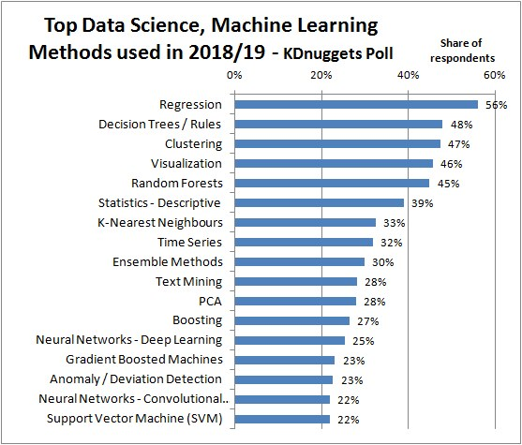
APPLICATIONS

Slide 9



Machine Learning Applications
Health Care
Diagnosis and disease identification
Medical imaging diagnostics
New drug discovery
Consumer Goods Speech recognition
Banking and Finance
E- commerce website
Notes:
https://www.soleblogger.com/best-machine-learning-applications-for-web-designing-building/

Slide 10
Data Science Methodology
Business understanding
Analytic
Approach

Slide 11
Data Science Methodology
Business understanding
Analytic
Approach
Data Requirements
Business Understanding
Data Collection

Slide 12
Data Science Methodology
Business understanding
Analytic
Approach
Data Requirements
Business Understanding
Data Collection
Data Understanding
Data Preparation

Slide 13
Data Science Methodology
Business understanding
Analytic
Approach
Data Requirements
Business Understanding
Data Collection
Evaluation
Data Understanding
Modeling
Data Preparation

Slide 14
Data Science Methodology
Business understanding
Analytic
Approach
Data Requirements
Feedback
Business Understanding
Deployment
Data Collection
Evaluation
Data Understanding
Modeling
Data Preparation

Slide 15
The general framework for ML algorithms
Almost all machine learning algorithms consist of 4 components:
the data
the model
the criterion
the optimiser

Slide 16
Types of Machine Learning Problems
1. Supervised
2. Unsupervised
3. Semi-supervised
4. Reinforced Learning

Slide 17
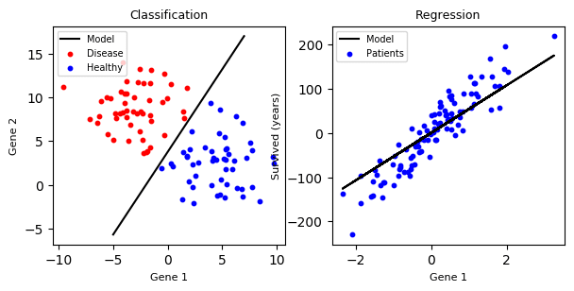
Types of Machine Learning Problems
Supervised
Regression
Continuous output / Price/Temp
Classification

Slide 18
Types of Regression Model
1. SIMPLE REGRESSON
LINEAR
2. MULTIPLE REGRESSION
LINEAR
NON-LINEAR
NON-LINEAR

Slide 19
The Linear Regression model
Label
Linear Regression model
Feature

Slide 20
Linear Regression model
bias
Prediction
weights
Feature

Slide 21
Linear Regression predicts weighted, shifted combinations of the features

Slide 22

Example - Data
Number of Rooms
Area
Age
X = [X⁽¹⁾ , X⁽²⁾ , X⁽³⁾ … X^{(m)}
X^{(i)} =
y^{(i)} =
Price
4
1000 sqft
32
X⁽³⁾ =
SARAH

Slide 23
Example - Model
4
10 sqft
32
If w = [ 10, 5, 0] and b = 2
X⁽³⁾ =
4
10
32
[ 10, 5, 0]
2
92
Predicted price

Slide 24
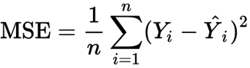
Evaluation : The performance criterion for linear regression
Target Output
= predictions
Feature
Mean Squared Loss ,
Notes:
https://www.kaggle.com/hely333/eda-regression

Slide 25
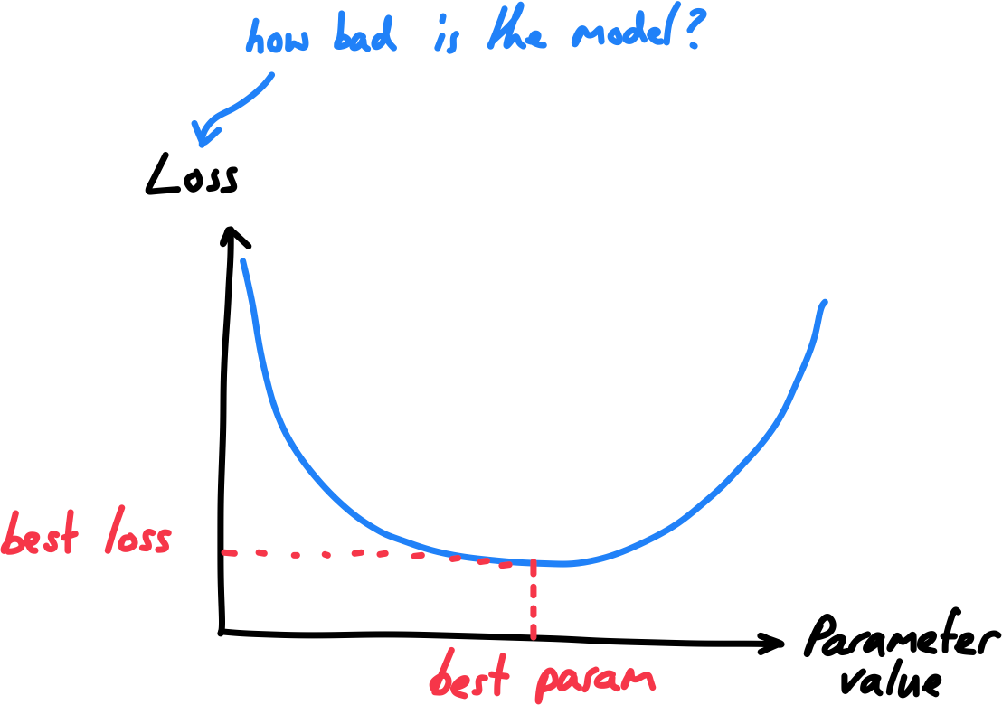
Optimization - Strategy to improve performance
Data
Model
Evaluation - model performance
Optimization

Slide 26






Python Libraries for Machine Learning

Slide 27
Useful Pandas Commands
pd.read_csv (for reading a file)
df.to_csv(r'Path where you want to store the exported CSV file\File Name.csv’) for Saving a file
df.head() View the first few lines of file
df.describe Find the count, mean, min, max, STD
df.corr() correlation
df.columns()
df.shape
Df.dtypes

Slide 28
Build the Model
The steps to building and using a model are:
Define: What type of model will it be? A decision tree? A regression model , a classification.
Fit: Capture patterns from provided data. This is the heart of modeling.
Predict: Just what it sounds like
Evaluate: Determine how accurate the model's predictions are.
Notes:
You will use the scikit-learn library to create your models. When coding, this library is written as sklearn, as you will see in the sample code. Scikit-learn is easily the most popular library for modeling the types of data typically stored in DataFrames.

Slide 29
Scikit learn
scikit-learn (abbreviated sklearn) is a high-level machine learning library containing:
machine learning algorithms
example datasets
data pre-processing & pipelines

Slide 30
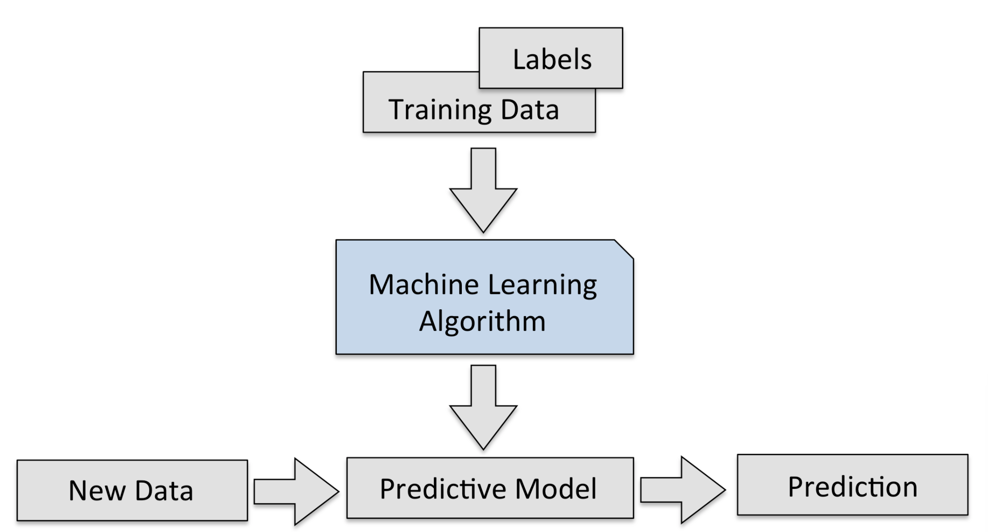
Linear Regression

Slide 31
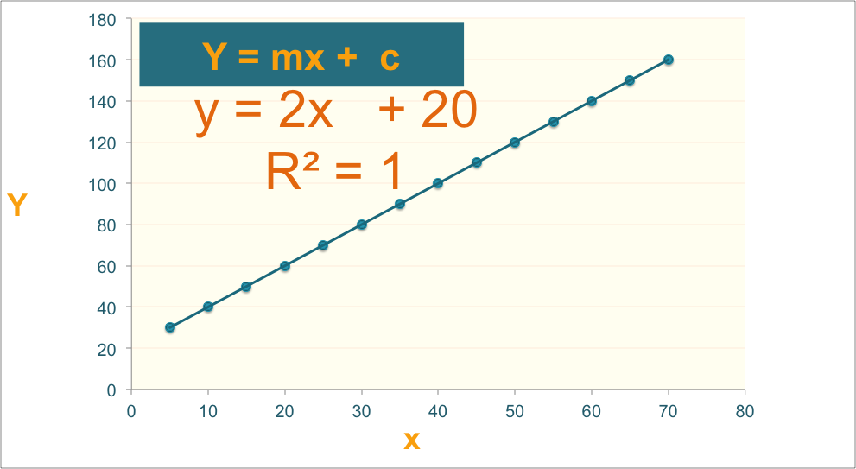
Linear Regression

Slide 32
Regression Algorithm
Ordinal Regression
Poisson Regression
Linear, polynomial, Lasso, Stepwise, Ridge Regression
Bayesian Network Regression
Neural Network Regression
Decision Forest Regression
Boosted Decision Tree Regression
K-nearest neighbors (KNN)

Slide 33
Data Preparation for modeling
Linear Assumption
Remove Noise
Feature Engineering
Remove Collinearity
Rescale Input

Slide 34
Model Evaluation
Regression Evaluation Metrics
Mean Squared Error (MSE),
Root Mean Square Error (RMSE) &
Mean Absolute Error (MAE)
R-squared (Coefficient of Determination)

Slide 35
Machine learning courses
https://www.kaggle.com/learn/overview
https://developers.google.com/machine-learning/crash-course
Andreww Ng’s Machine learning course
IBM Data Science Professional Certificate (PAID)
Machine Learning with TensorFlow on Google Cloud Platform Specialization
Machine Learning Data Science Course (Harvard University)
Fast.ai course

Slide 36
Upcoming Courses
Pandas for Data Analysis
SQL Basics for Data Science
Complete a project and add to your Github portfolio

Slide 37
Pandas for Data Analysis
Getting Started with pandas
Package Overview
Exploring panda
Essential Basic Functionality
Introduction to Data Structures
Comparison with Other Tools
User Guide

Slide 38
Upcoming Courses
Pandas for Data Analysis
Getting Started with pandas
Package Overview
Exploring panda
Essential Basic Functionality
Introduction to Data Structures
Comparison with Other Tools

Slide 39
Pandas for Data Analysis
User Guide
Indexing and Selecting Data
MultiIndex/Advanced Indexing
Merge, Join, and Concatenate
Reshaping and Pivot Tables
Working with Text Data, Missing Data, and Categorical Data
Nullable Integer Data Type
Visualisations
Computational Tools
Group By: Split-Apply-Combine
Time Series and Time Deltas
Stylings
Options and Settings
Enhancing Performance
Sparse Data Structures
pandas Ecosystem
Statistics and Machine Learning
Visualisation
IDE
Data Validation
Extension Data Types

Slide 40
Feature Engineering
Feature extraction

Slide 41

Flourishing Life
Home Courses Blog
Get Started
We help you launch your data science career
Learn More

Slide 42
Flourishing Life
Home Courses Blog
Get Started
Python Foundation
Data Analysis with Python Pandas
SQL Basics for Data Science
Machine learning Level-2
Deep Learning
Courses
Machine Learning
Level-1
Amazon Web service Machine Learning Foundation
Apache Spark for Machine Learning and Data Science
Fast Data Visualization with Python

Slide 43
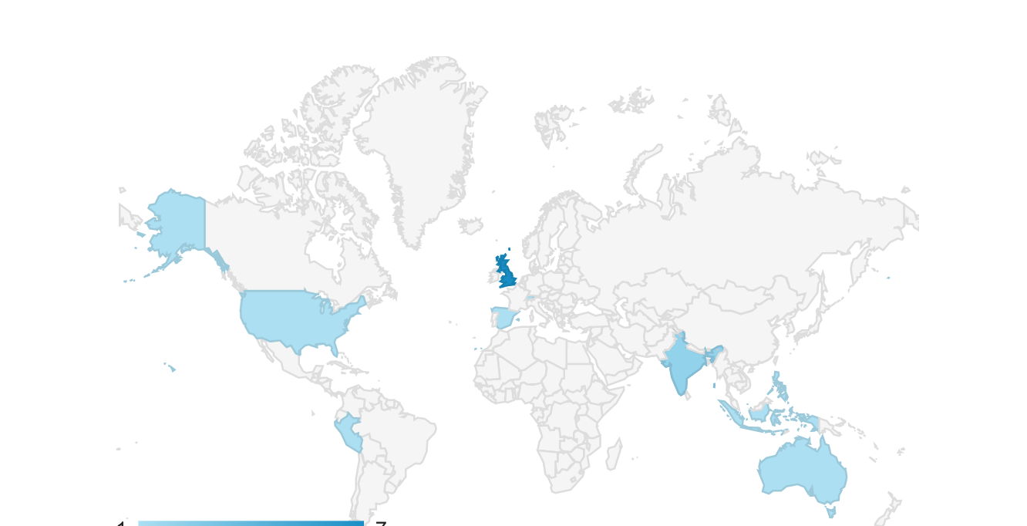
Courses
Flourishing Life
Home Courses Blog
Get Started
Where our students are from

Slide 44
Flourishing Life
Home Courses Blog
Get Started
Learn More
Get Started

Slide 45
Courses
Home Courses Blog
Get Started
Launch your career
Blog
Showcase
Try our neural network projects.
Check what you can build
Resources and Scholarships

Slide 46

Courses
Home Courses Blog
Get Started
Resources and Scholarships
Get Started

Slide 47
Courses
Home Courses Blog
Get Started
N=118 | Predicted No | Predicted Yes
True Negative (NO) | TN = 74 | FP = 6 | 80
True Positive (Yes) | FN = 27 | TP = 11 | 38
 | 101 | 17

Slide 48
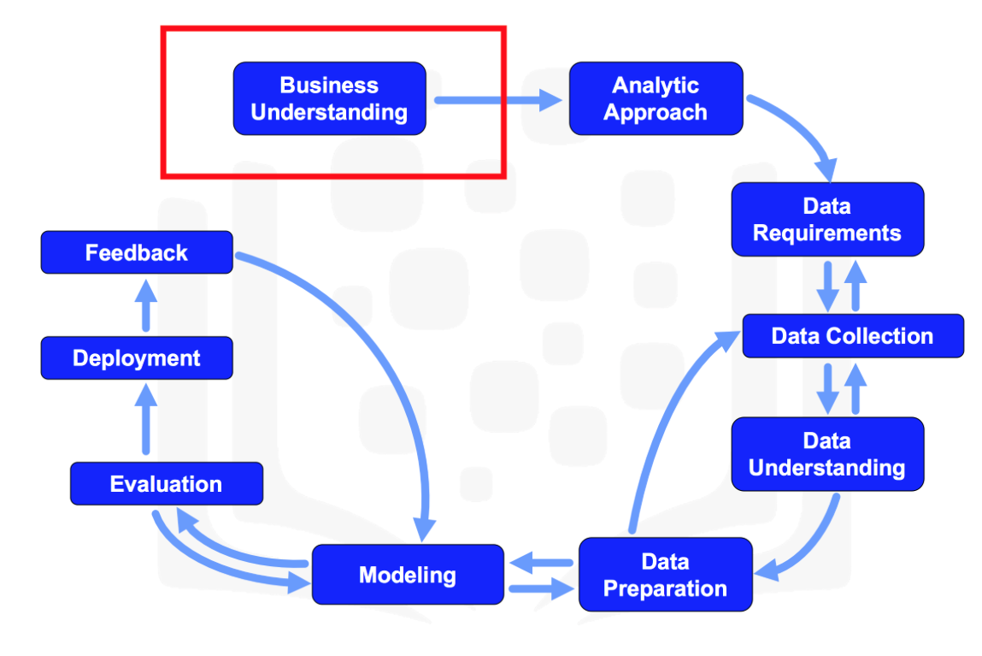

Slide 49
Data preparation and visualization
Dr. Suraiya Zabeen

Slide 50
What is going to be covered
Data Cleaning
- Check if there is missing values in your data
- String Manipulation
Application of regular expression
Pandas groupby
Creating functions, lambda function, applying functions

Slide 51
Learning Outcome
Data visualization
Histogram
Choropleth map
Bar plot

Slide 52
Predicting fine particulate matter PM 2.5 using machine learning approach

Slide 53
The impact
Coronavirus
2.4 millions in one year
Air pollution
3 million/year

Slide 54
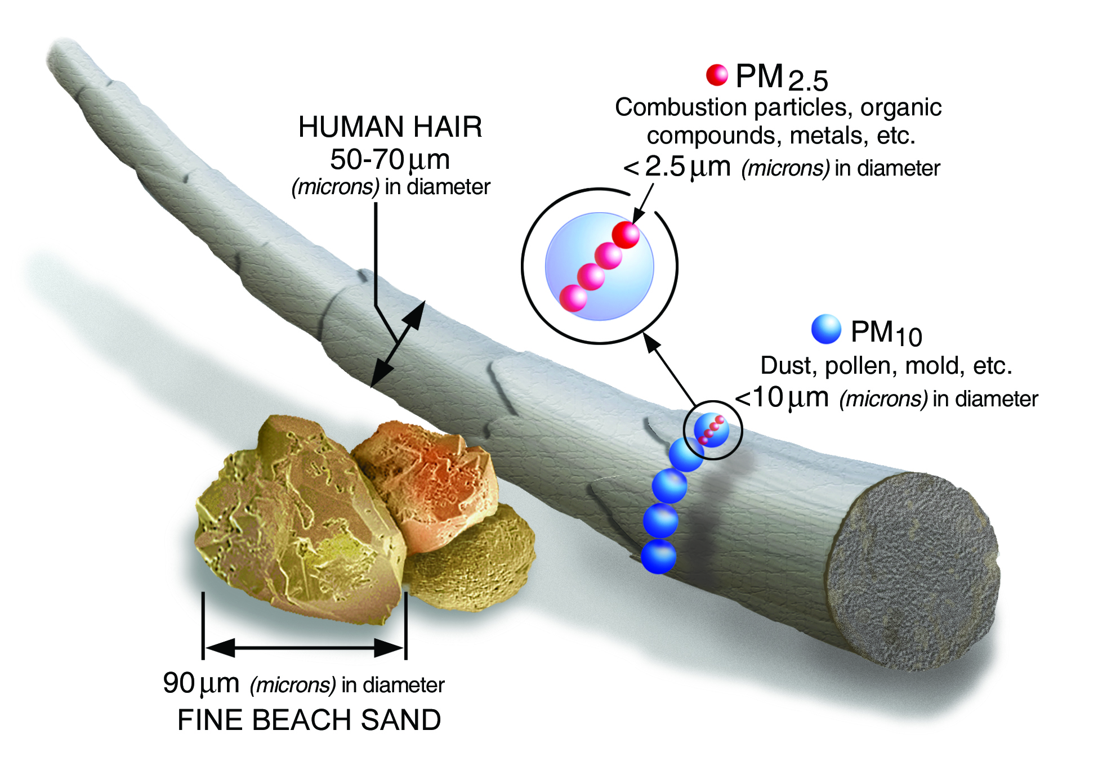
What is PM2.5?

Slide 55
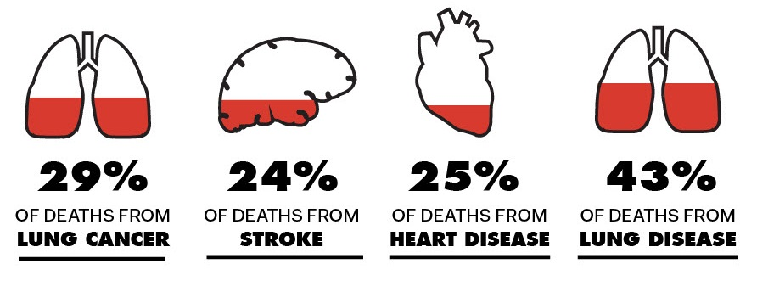
Health Effects of Particulate Matter (PM)
Poor air quality 36,000 people per year in the UK –that’s 7% of total death – bhf.org.uk
Heart and lung disease and stroke

Slide 56
7% of total death caused by air pollution
Cardiovascular disease cost UK economy £29.1 billion
60% of the cost accounted for CVD related health care ~ £17.5 billion pounds
Source: Heart. 2006 Oct; 92(10): 1384–1389.

Slide 57
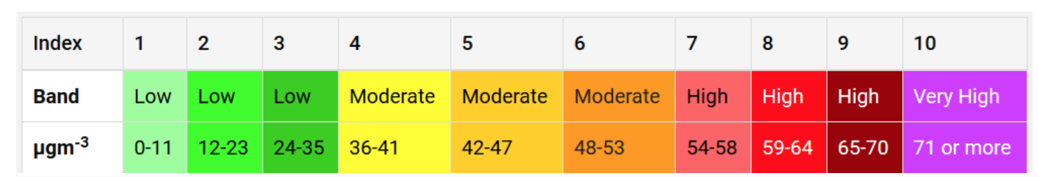
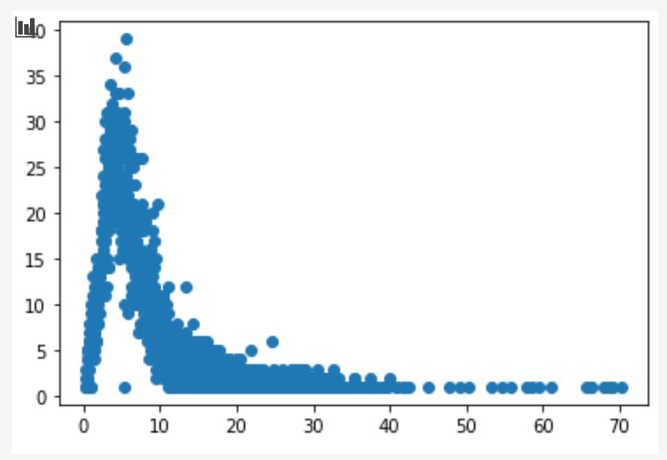
PM 2.5 Concentration Banding
Fine particulate matter (PM2.5)
10 μg/m3 annual mean
25 μg/m3 24-hour mean

Slide 58
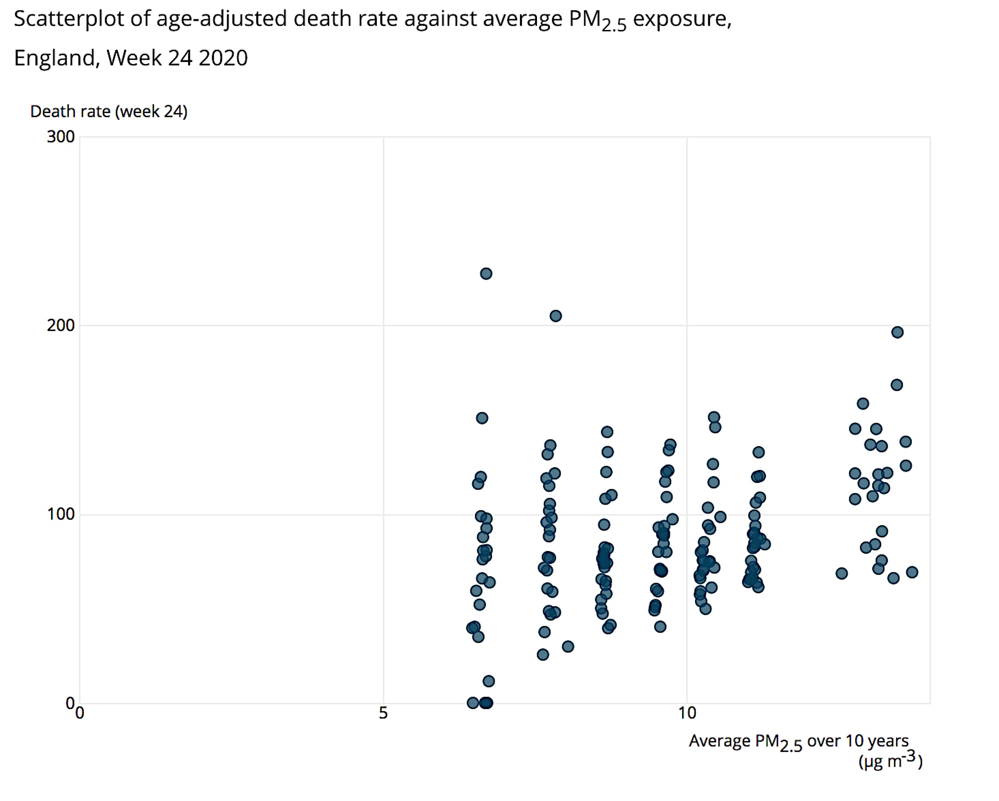
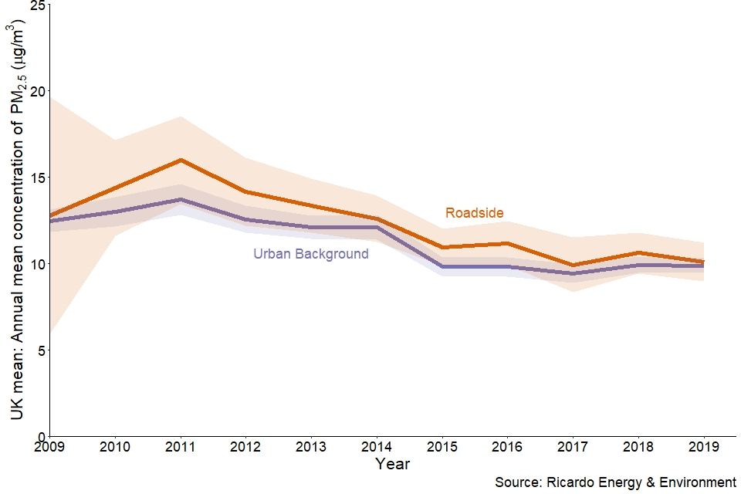

PM 2.5

Slide 59

Stakeholders
People who has preexisting heart and lung condition, asthma and risk of strokes including children
Commuters who spend more than
2 hours commuting everyday
People living in houses near major
road with frequent traffic
Highway and railroad rail workers.
Sales person, shop owners of open
markets near major roads.

Slide 60
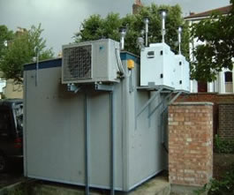
Data: Automatic air quality monitoring station
London North Kensington site
Altitude (metres): 5
Environment Type: Urban Background
Hourly measured Data used from
1st January 2020 to February 2021
Source: https://uk-air.defra.gov.uk/
Notes:
There are 300 hundred monitoring site across UK

Slide 61
Features and Targets
Ozone
Nitric oxide
Nitrogen dioxide
Nitrogen oxides as nitrogen dioxide
Sulphur dioxide
Carbon monoxide
Modelled Wind Direction
Modelled Wind Speed
Modelled Temperature
PM2.5
concentration Band
PM 2.5 < 10 μg/m⁻³ = low pollution, no alert
PM 2.5 > 10 μg/m⁻³ high pollution, alert
Rainfall
Sun Exposure
Relative Humidity

Slide 62
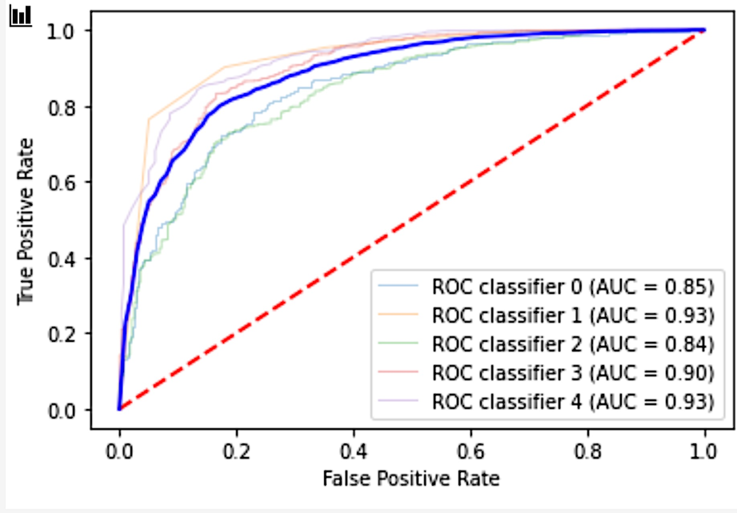
Learners trained
0. Logistic Regression
KNN Classifier
Linear Support Vector
RBF Support Vector
Radom Forest

Slide 63
Hyperparameter Optimzation
I used GridsearchCV with 4 fold cross validation

Slide 64
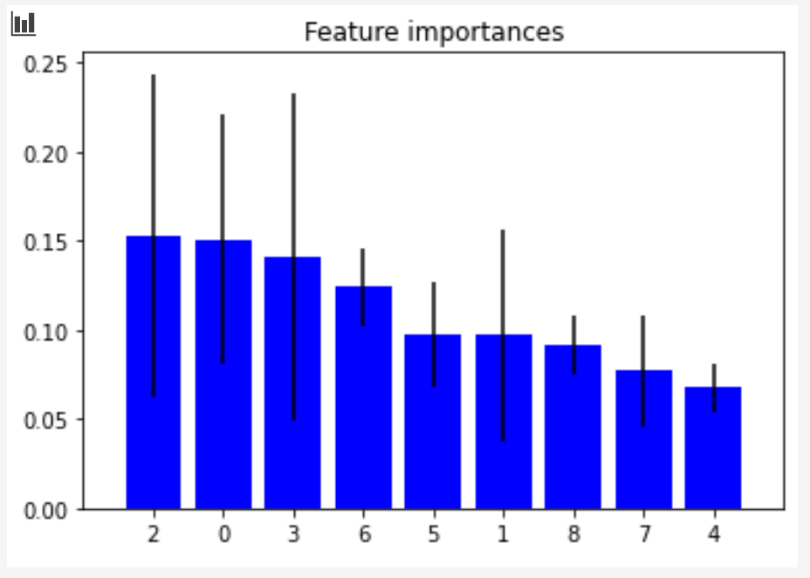
Feature Ranking
Feature ranking:
1 | Nitrogen dioxide | 0.153
2 | Ozone | 0.151
3 | Nitrogen oxides as nitrogen dioxide | 0.141
4 | Modelled Wind Direction | 0.124
5 | Carbon monoxide | 0.098
6 | Nitric oxide | 0.097
7 | Modelled Temperature | 0.092
8 | Modelled Wind Speed | 0.077
9 | Sulphur dioxide | 0.067

Slide 65
Random Forest Model Performance
N=118 | Predicted No | Predicted Yes | All
True Negative (NO) | TN = 208 | FP = 129 | 337
True Positive (Yes) | FN = 51 | TP = 1257 | 1308
All | 259 | 1386

Slide 66
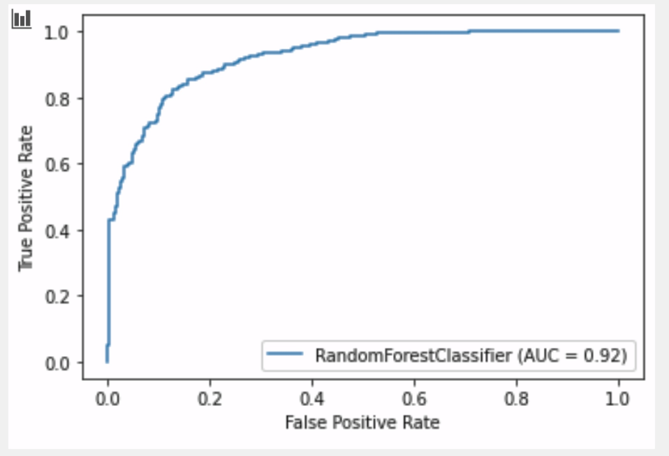
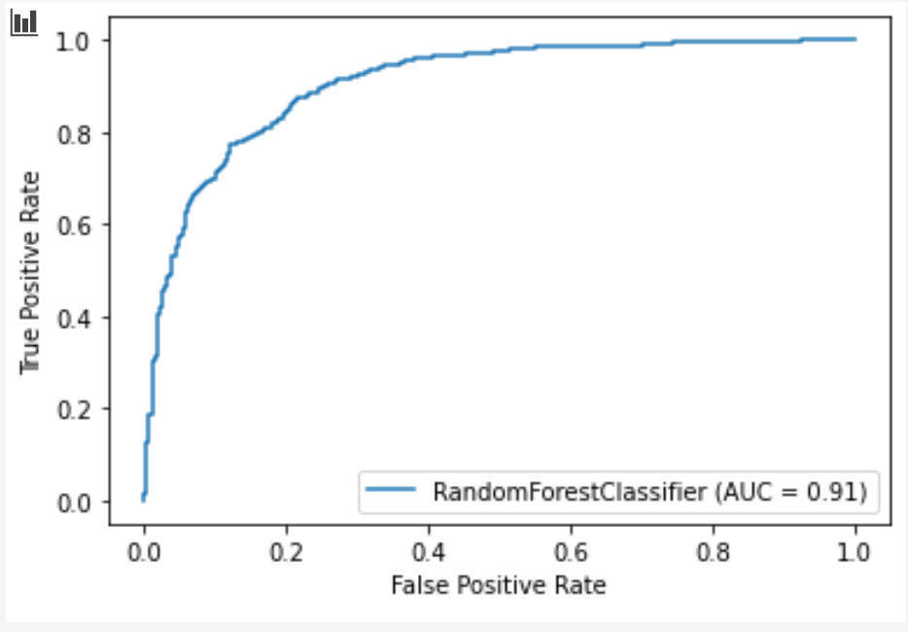
Random Forest Model Performance
Validation set
Test set

Slide 67
How success is going to be measured?

Slide 68
Health and Environmental Effects of Particulate Matter (PM)
Health Effects
The size of particles is directly linked to their potential for causing health problems. Small particles less than 10 micrometers in diameter pose the greatest problems, because they can get deep into your lungs, and some may even get into your bloodstream.
Exposure to such particles can affect both your lungs and your heart. Numerous scientific studies have linked particle pollution exposure to a variety of problems, including:
premature death in people with heart or lung disease, cardiovascular disease
nonfatal heart attacks,
irregular heartbeat
aggravated asthma
decreased lung function
increased respiratory symptoms, such as irritation of the airways, coughing or difficulty breathing.
Professional air purifier companies such as dyson, Blueair , Philips.
Large cities in third world countries, which don’t have the air quality measuring stations.
Children and adults with chronic obstructive pulmonary disease (COPD), pneumonia, myocardial infarction (MI), lung cancer, and heart failure (HF) and risk of stroke. They can check predicted air quality in the dashboard

